Slide 1
Toxic E-waste Dumped In Developing Countries

Slide 2
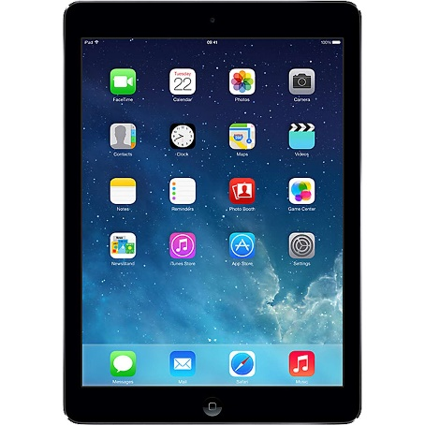
E-waste Defined by US Environmental Protection Agency
Electrical and electronic equipment that is dependent on electric currents or electromagnetic fields in order to function
E-waste may include
Consumer/entertainment electronics
Devices of office, information and communications technology
Household appliances
Lighting devices
Power tools
Devices used for sport and leisure

Slide 3
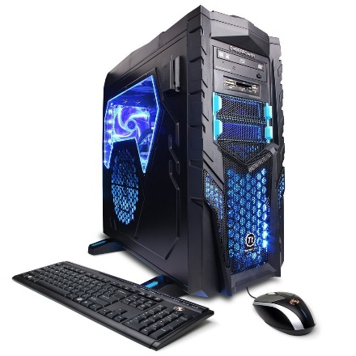
Electrical vs Electronic E-waste
Electrical e-waste
Products that use electricity primarily for energy
Washing machine
Power tools
Refrigerator
Electronic e-waste
Products that use electricity to manipulate data
Desktop, Laptop
Smartphones
Game consoles
Televisions

Slide 4
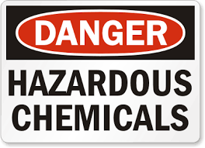
E-waste Hazardous Materials
Arsenic
Barium
Beryllium
Brominated flame retardants (BFRs)
Cadmium
Chromium
Lead
Mercury
Polychlorinated biphenyls (PCBs)
Polyvinyl chloride (PVC)
Selenium

Slide 5
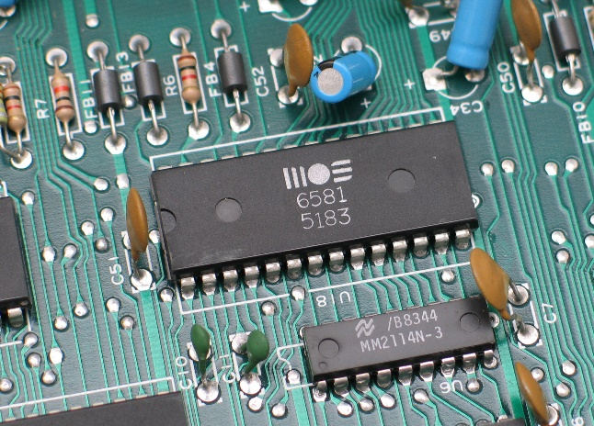
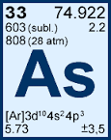
Arsenic
Present in
circuit boards
LCD displays
computer chips
Strong link between arsenic exposure and:
lung cancer
skin cancer
bladder cancer

Slide 6
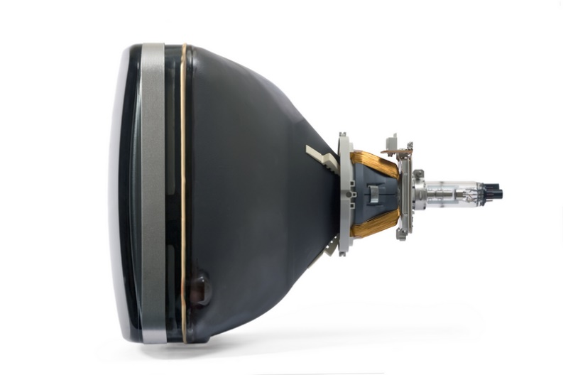
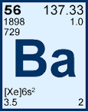
Barium
Present in
cathode ray tubes (CRT)
Strong link between barium exposure and
heart disease
nervous system disorders
numbness
muscle weakness
stomach and intestine disorders

Slide 7
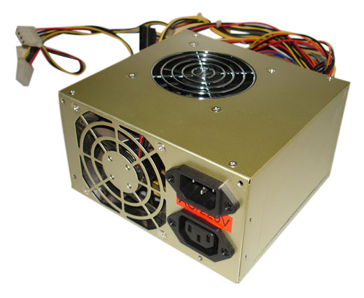
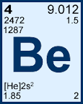
Beryllium
Present in
power supply boxes
Strong link between beryllium exposure and
Lung cancer
considered a Group 1 - Carcinogenic
affects liver, kidneys, heart, nervous system, and the lymphatic system.

Slide 8
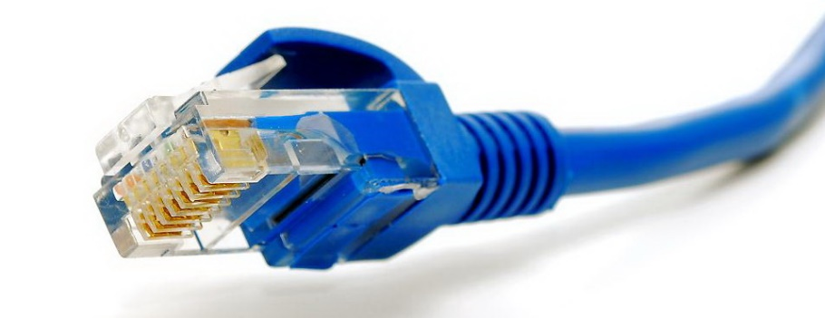
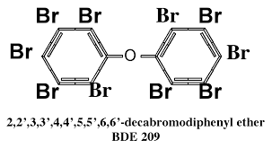
Brominated flame retardants (BFRs)
Present in
plastic parts
cable insulation
Link between BFR exposure and
Thyroid cancer
Notes:
Fire retardants for plastics

Slide 9
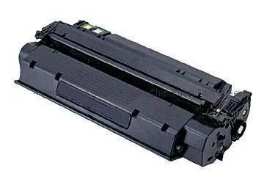
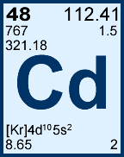
Cadmium
Present in
rechargeable batteries
CRT screens
printer ink cartridges and toners
printer drums
Strong link between cadmium exposure and
Lung disease
Kidney failure

Slide 10
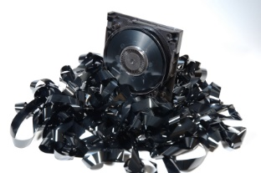
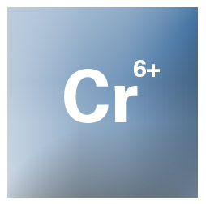
Chromium VI
Present in
Data tapes
Floppy discs
Strong link between chromium VI exposure and
Lung cancer
Kidney disease
Liver disease

Slide 11
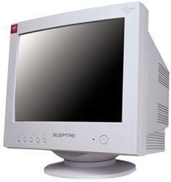
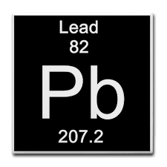
Lead
Present in
CRT screens
Batteries
Printed circuit boards
Strong link between lead exposure and
Decreased intelligence in children
Nerve disorders
Fertility problems
Memory and concentration problems

Slide 12
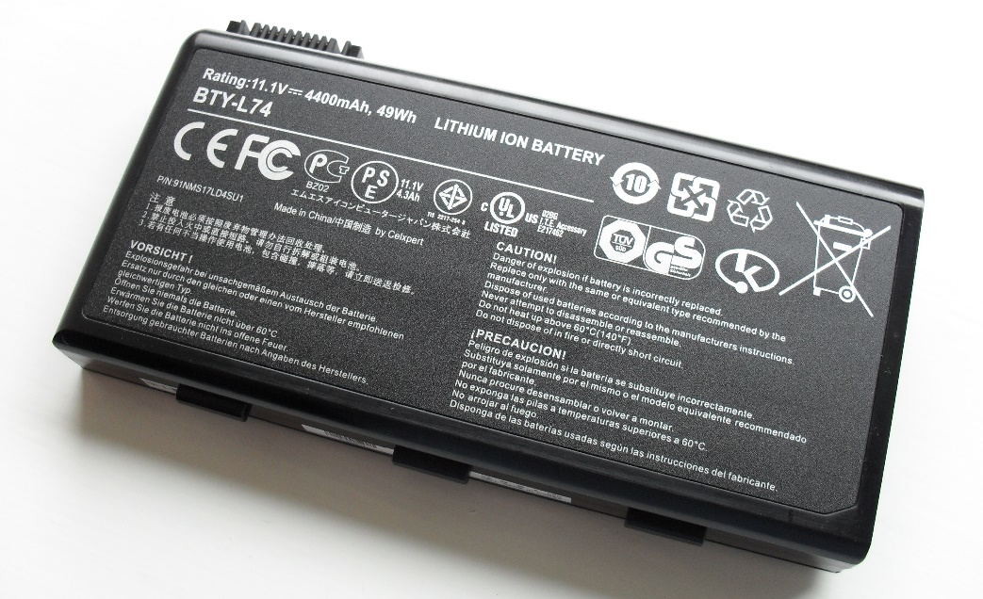
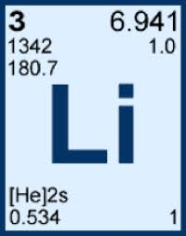
Lithium
Present in
Li-batteries
Hazards of lithium exposure
Contact with eyes causes caustic irritation or burn
Reacts with body moisture to cause chemical burns

Slide 13
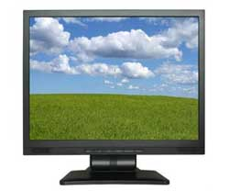
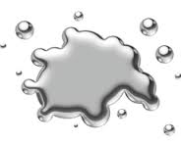
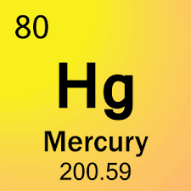
Mercury
Present in
LCD back lights
Batteries
Switches
Hazards of mercury exposure
Damage to nervous system
Damage to muscles

Slide 14
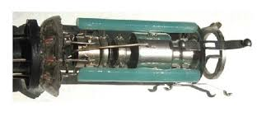
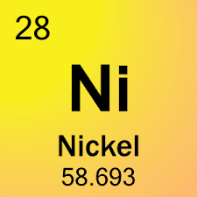
Nickel
Present in
Electron gun in CRT screens
Batteries
Hazards of nickel exposure
Lung cancer
Neurological deficits
Cardiovascular disease

Slide 15
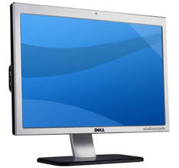
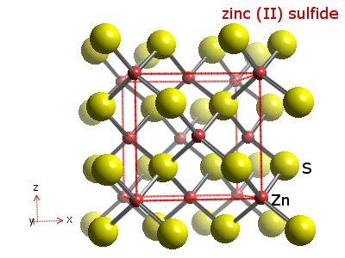
Zinc Sulfide
Present in
CRT screens
Hazards of zinc sulfide
When burned causes “brass founders” disease
characterized by malaria like symptoms

Slide 16
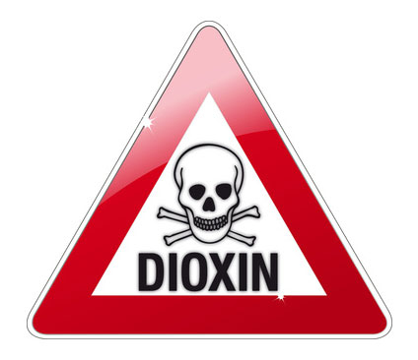
Dioxins
Environmental pollutants
Typically byproducts of industrial processes
Stored in fatty tissue
Half life is 7 to 11 years
Persistent in the environment
Effects
nervous system
immune system
endocrine system
proven to cause cancer

Slide 17
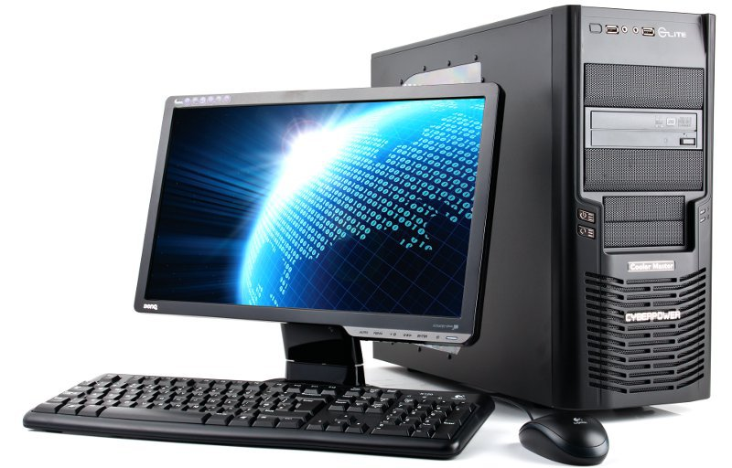
Amount of Hazardous Materials in 30 lb. PC
15 lb. – Plastics
4.3 lb. – Lead
0.693 g – Mercury
0.409 g – Arsenic
2.961 g – Cadmium
1.98 g – Chromium
9.92 g – Barium
4.94 g – Beryllium

Slide 18
Issues About Consumer Electronic E-waste
E-waste currently makes up between 1 to 2 percent of municipal solid waste
Growing number of consumer electronic products
438 million consumer products were sold in 2009
Doubling since 1997
Smartphone units increased by seven fold between 1997 - 2009
Disposing e-waste in landfills is not an optimal solution
Manufacturing inputs are high in energy and comprise scarce resources
Highly toxic materials are included in consumer electronic products

Slide 19
General Problems with Landfills
Landfills are toxic
toxic substances in products dumped in landfills leach into soil and groundwater
Landfills form leachate
water the percolates through waste extracting and becoming toxic
Landfills produce greenhouse gases
methane is 21 time more potent than carbon dioxide in trapping heat
Landfills not properly designed and managed are dangerous to human health
Nigeria with 155 million people does not have a licensed landfill

Slide 20
States Regulate Landfills
Twenty-five states have e-waste laws on the books
Orange states have some regulations regarding disposal of e-waste
NEW JERSEY
Beginning 2011 it is illegal to discard e-waste in general trash.
All businesses and households must recycle electronic items

Slide 21
Business of E-recycling Emerges
Given new restrictions traditional scrap dealers stepped in
Offered a new service now in demand
renamed the business “e-recyclers”
For a fee the e-recyclers take e-waste and dispose of it
Recycling e-waste is labor intensive
E-waste however is not profitable to recycle

Slide 22
Recycling a Cathode Ray Tube (CRT)
CRTs contain toxic substances and are considered hazardous waste
Recyclers can recover a few dollars worth of copper
Recycling a CRT responsibly results in a net loss
Someone has to pay to properly recycle a CRT
Exploiting the available labor in developing countries makes it profitable
Labor is cheap
Environment laws unenforced
Labor safety laws unenforced
It can be ten times more profitable to export e-waste abroad

Slide 23
Basel Convention
The Basel Convention on the Control of Transboundary Movements of Hazardous Wastes and their Disposal
Negotiated under United Nations Program
Goal is to promote environmentally sound management of exported and imported waste
United States signed but did not ratify
Despite convention e-waste still makes its way from Europe

Slide 24
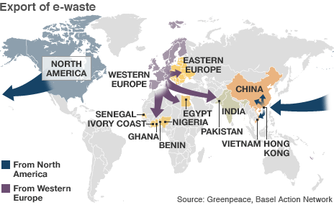
Where Does e-waste Go To?
Africa
Ghana
Nigeria
China
Vietnam
Malaysia
India
Indonesia
Pakistan

Slide 25
Primitive Recycling Methods Used in Developing Countries
Use hands to break apart components for
gold, silver, copper and chips
Cook circuit boards to melt solder
remove chips
Burn wire to extract copper
burning creates dioxins
Use acid baths to remove gold from microchips
dump used acid into river

Slide 26
Two Infamous e-waste locations
Guiyu, China
Accra, Ghana

Slide 27
Guiyu, China
Notes:
Pronounced Gwhy - you

Slide 28
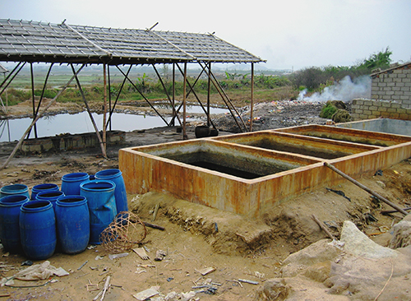
Chips removed from circuit boards are soaked in acid to remove small amounts of gold. Acid waste is dumped into fields and rivers
Basel Action Network (BAN)

Slide 29
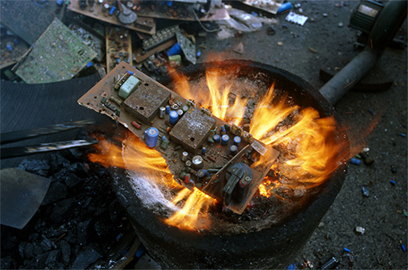
Circuit board is cooked over heat to melt solder and then remove electronic components
Basel Action Network (BAN)

Slide 30
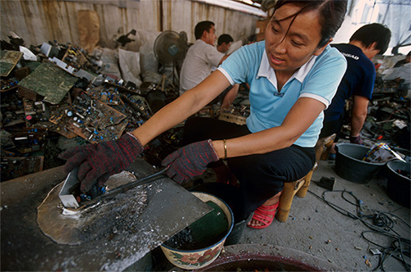
Workers suffer chronic exposure to lead and dioxins emitted from melting solder
Basel Action Network (BAN)

Slide 31
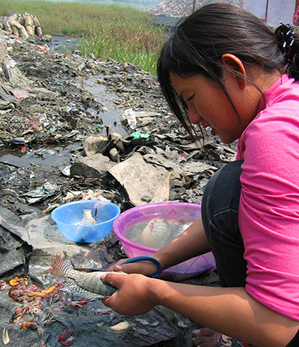
Fish are caught and cleaned in places where electronic waste is processed and dumped
Basel Action Network (BAN)

Slide 32
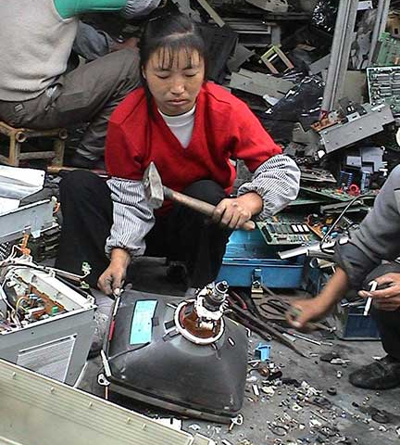
About to smash CRT to get copper from yoke and releasing a collection of toxic compounds
Basel Action Network (BAN)

Slide 33
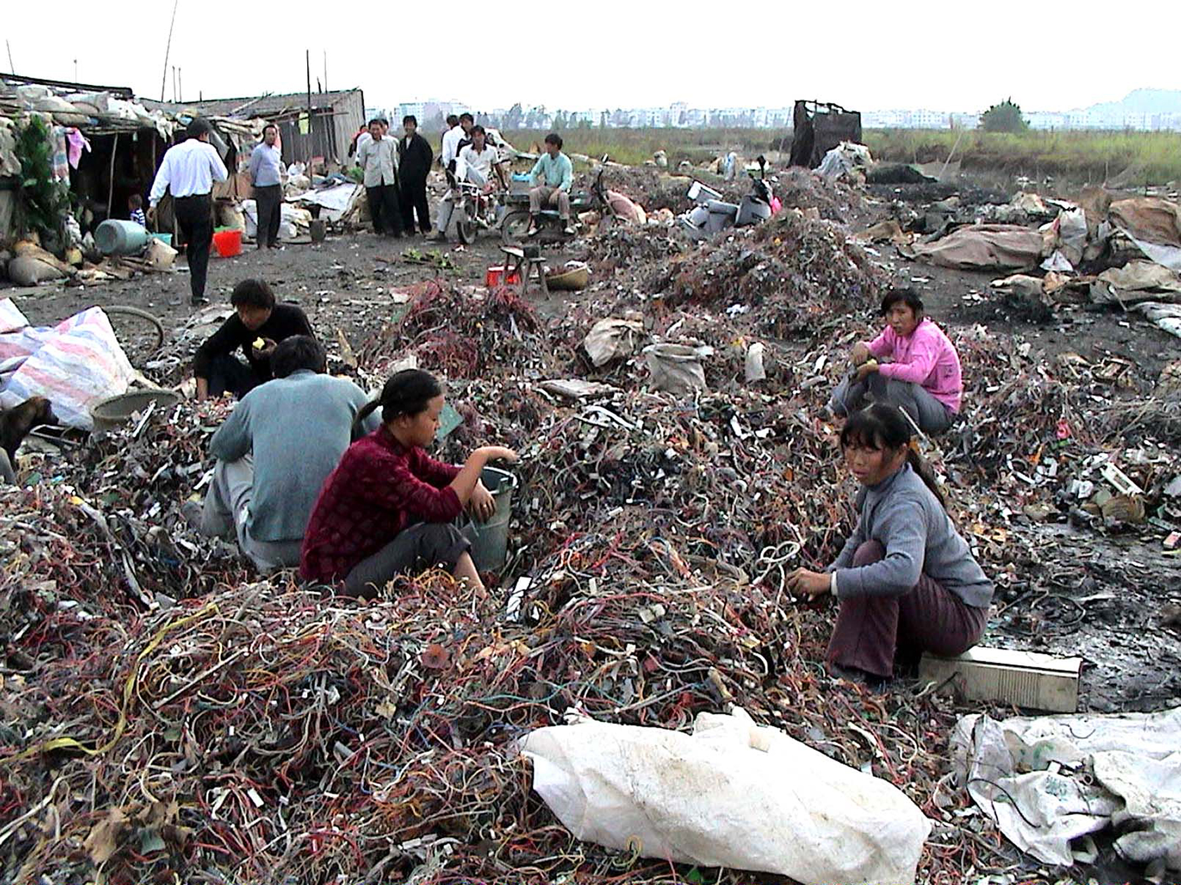
Wires are sorted during the day and burned at night. Burning the PVC and brominated insulation on the wires produces dioxins
Basel Action Network (BAN)

Slide 34
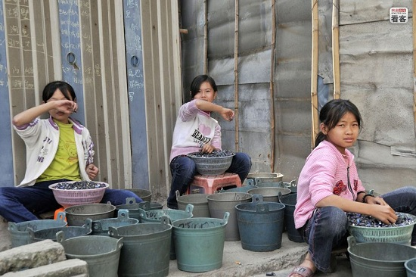
Girls sorting e-waste components fearful of having picture taken.
Basel Action Network (BAN)

Slide 35
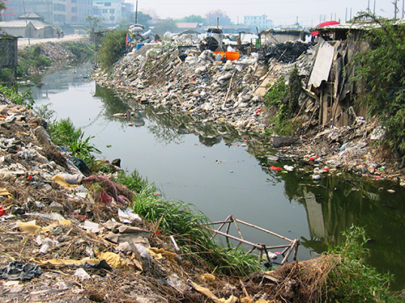
E-waste that cannot be recycled is discarded along rivers and streams
Basel Action Network (BAN)

Slide 36
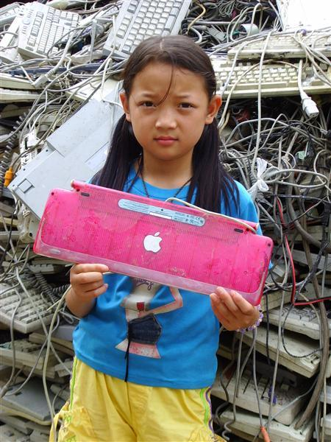
An iMac keyboard produced from 1999 - 2003
Basel Action Network (BAN)

Slide 37
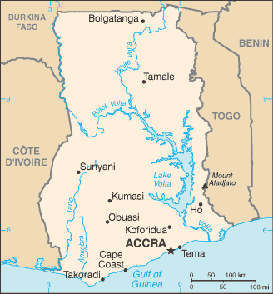
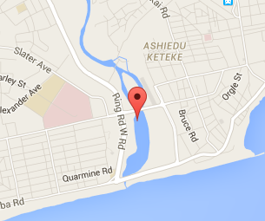
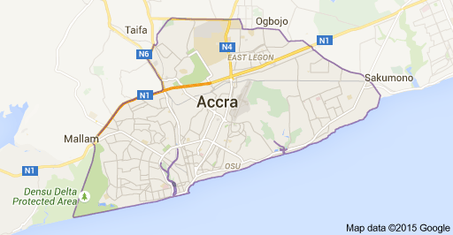
Accra, Ghana
Notes:
pronounced: uh-krAA

Slide 38
Recycling in Accra, Ghana
Even more primitive and dangerous than Guiyu, China
Less organized
Less sorting
E-waste is disassembled in makeshift fashion
Less interest in circuit board components
Metals are mostly sought after
More burning of e-waste
creating greater amounts of dioxins

Slide 39
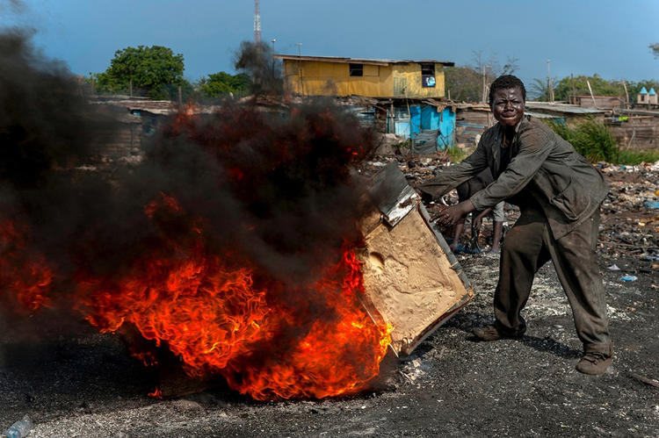
Worker burns insulation from refrigerator on top of computer
© RENÉE C. BYER

Slide 40
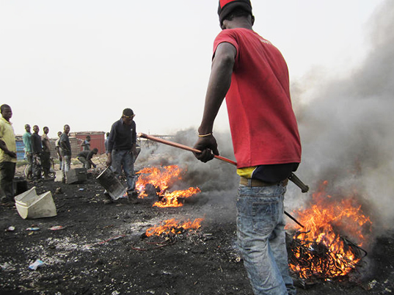
Power cords, internal wires and a variety of cables are balled up and burned. What’s left in the ashes is melted copper and aluminum
Basel Action Network (BAN)

Slide 41
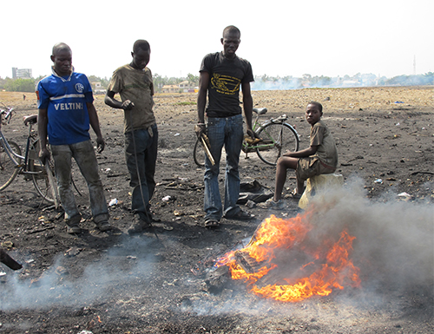
The constant burning of e-waste pollutes the ground and air with heavy metals and dioxins
Basel Action Network (BAN)

Slide 42
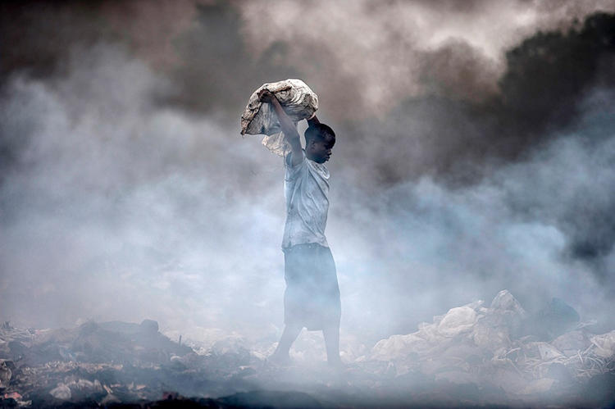
Workers are exposed to acute and chronic levels of dioxins
© RENÉE C. BYER

Slide 43
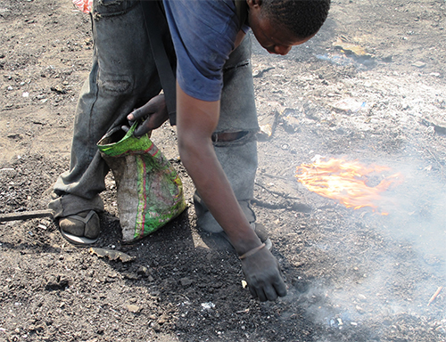
Individuals scrap through the ashes for bits of metals
Basel Action Network (BAN)

Slide 44
The once pristine Korle Lagoon is now a toxic dump of e-waste
Basel Action Network (BAN)

Slide 45
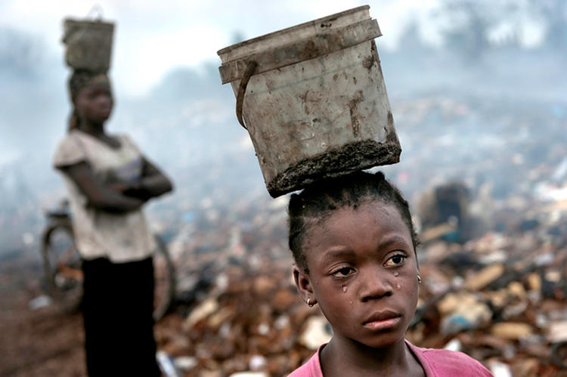
Eight year old child combs through toxic debris attempting to scavenge anything of value
© RENÉE C. BYER

Slide 46
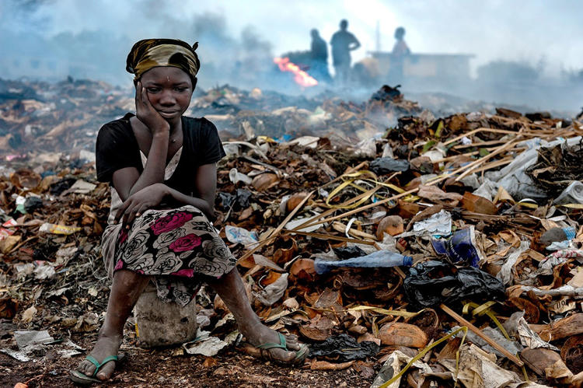
Ten year old child’s daily existence in the toxic dump of Accra
© RENÉE C. BYER

Slide 47
Steps to decrease the export of e-waste
US could ratify the Basel Convention
E-recyclers could be regulated and audited
assuring no e-waste is exported
External costs of e-recycling born by manufacturer
included in price of component
incentive for manufacturers to make components profitable to recycle
Increase aid to developing countries

Slide 48
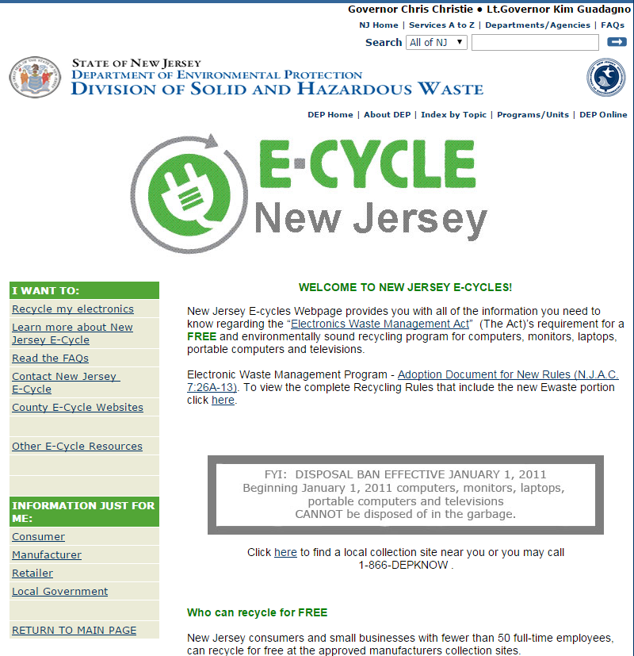
E-recycling in New Jersey
http://www.state.nj.us/dep/dshw/ewaste/

Slide 49
Best Buy as a Responsible Solution

